Slide 1
Literature review – The Matrix Profile
Corso di Laurea Magistrale in Ingegneria Energetica e Nucleare
Student: Simone Dehò
June 2021

Slide 2
Existing literature on Matrix Profile applied to the Energy and Buildings research field
Currently, the literature regarding the applications of the Matrix Profile method in the Energy and Buildings research field is very sparse.
To the best of my knowledge, there are only three papers that talk about the potential uses of the Matrix Profile to analyze buildings’ energy profiles in order to discover anomalies and other useful information.
These three papers are:
«Learning Dominant Usage from Anomaly Patterns in Building Energy Traces», Nichiforov et al., 2020
«Information Extraction Approach for Energy Time Series Modelling», Nichiforov et al., 2020
«The good, the bad and the ugly: Data-driven load profile discord identification in a large building portfolio», Park et al., 2020
In the next few slides, I will shortly present these papers and the main contributions made by each one of them.

Slide 3
«Learning Dominant Usage from Anomaly Patterns in Building Energy Traces», Nichiforov et al., 2020
This paper introduces the Matrix Profile as a powerful tool for the study of large buildings’ energy consumption profiles in order to: 1) build a dataset of anomaly patterns, looking for the top discords (when do they happen? Can we explain their presence in relation to well-known periods such as holidays, and so on?) in each building’s energy time series and 2) create a supervised learning classification model that learns these anomaly patterns and is able to assign newly observed data to the correct type of building (each building is associated with a different dominant usage pattern).
The paper presents the experimental results of the described approach on a reference building energy dataset. The dataset used contains the energy consumption for 507 university buildings from Europe and USA over one year period. The sampling time for each data-set is one hour and the they consists of 8.760 data points. Four types of dominant energy usage patterns were identified: classrooms, offices, laboratories and dormrooms, for a subset of 422 buildings. The MP was applied on all 422 datasets, grouped by each type of dominant usage pattern: classroom, office, laboratory and dormroom.
The results shown are promising: the researchers were able to explain the various observations, such as MP values distributions and top-3 discords locations, with known events and occupation trends, and the classification model based on MP discord features was able to achieve relatively high accuracy despite a considerable decrease in training time compared to using the full year energy readings in the modelling stage.
The authors claim that this approach could prove useful for exploiting complementary energy consumption patterns in a decentralised control structure that aims for grid balance and economic operation.

Slide 4
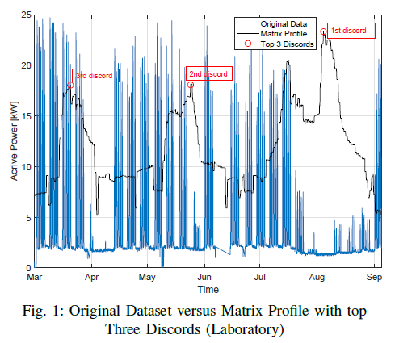
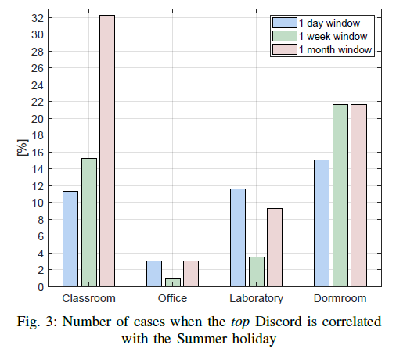
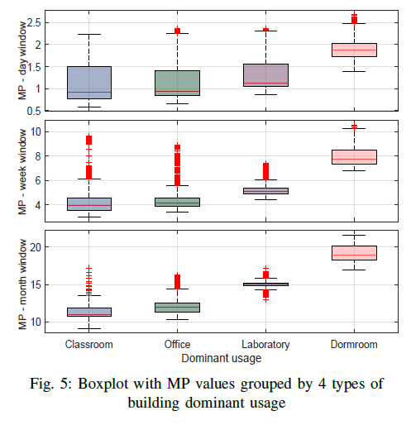
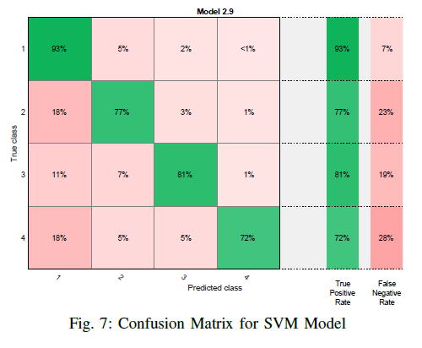
«Learning Dominant Usage from Anomaly Patterns in Building Energy Traces», Nichiforov et al., 2020

Slide 5
«Information Extraction Approach for Energy Time Series Modelling», Nichiforov et al., 2020
This paper, whose authors are the same of the previous one, mainly aims at proving that the Matrix Profile can be used for domain-specific information extraction from building energy time series; once again, the discords from the energy profiles of a large academic buildings dataset, which comprises various dominant usages such as classrooms, laboratories and offices, are studied in relation to the time when they happen (can we infer something about why a discord happens at a certain time?); distributions of MP values are also examined: how are the MP values of a certain kind of buildings distributed? Are the average MP values lower on a weekend or on a weekday? Is there a day of the week that shows interesting distributions?
The Manhattan distance, which is calculated as the sum of the absolute values of the differences of the various dimensions between 2 points, is also introduced to evaluate the differences in results when compared to the traditional Euclidean distance. The results show that the MP calculated with the Manhattan distance is noisier, but it shows an overall trend that is similar to the standard MP. The authors suggest that smoothing out this noisier MP would result in a highly similar distance metric profile with less computational time required.
The last point the authors make is that MP could be used for model-free load forecasting. They applied this technique to a specific building and concluded that the prediction performance is not as high as other methods commonly used for this purpose, but the lower performance is compensated by faster model selection and training, which is well-suited for real-time local control.

Slide 6
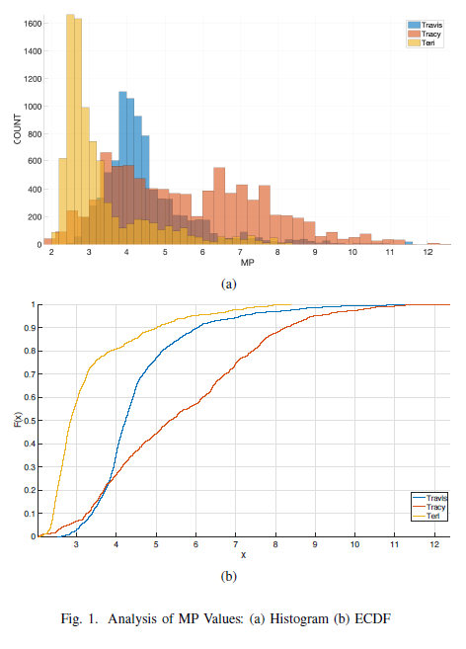
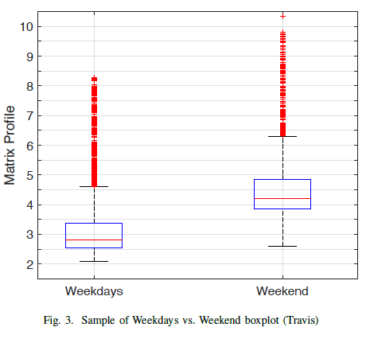
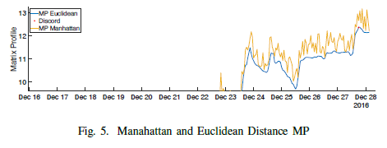
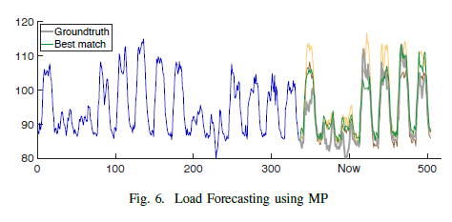
«Information Extraction Approach for Energy Time Series Modelling», Nichiforov et al., 2020

Slide 7
«The good, the bad and the ugly: Data-driven load profile discord identification in a large building portfolio»
This paper introduces a method for Automated Load profile Discord Identification, called ALDI, and shows its application to a large building portfolio (>100 buildings). In this framework, the Matrix Profile is used mainly in the first step, in order to obtain daily MP values for each building in the portfolio. The MP values are then grouped by typical day types and a statistical evaluation is performed to compare how individual days’ MP distributions are similar (or dissimilar) against the typical days’ MP distributions. Finally, the days marked as anomalous are analyzed one by one in order to gain insight about why a certain day is classified as a discord after the statistical test.
One of the most interesting aspects about this work, in my opinion, is how the first simple and «domain-agnostic» MP step is then followed by a «domain-expert heavy» series of analyses, after intermediate statistical tests. This approach seems promising, but also not so simple to implement in a generalized way (the authors also remark that the choice of the p-value for statistical tests is not trivial).
Taking into consideration a building portfolio and no longer a single building also means that the discords need to be identified in a different way from the ones previously seen, thus requiring analysis on the distribution of MP values in order to complete this task.
The authors suggest that their work could prove particularly useful for portfolio managers, in order to diagnose multiple buildings, that have similar discord load shape patterns because they belong to the same geographical region and are connected with the same electrical grid and metering facility, in terms of discord days.

Slide 8
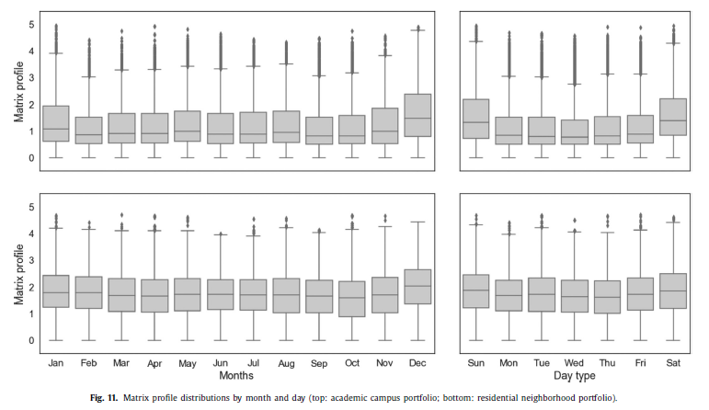
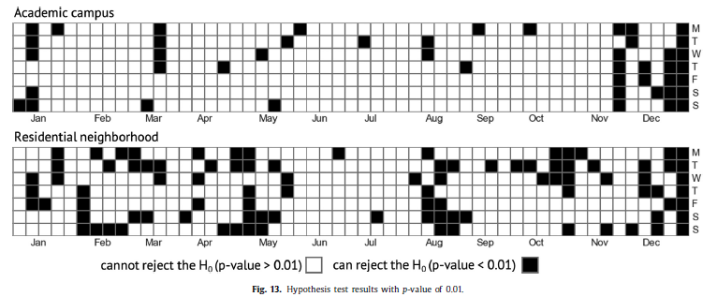
«The good, the bad and the ugly: Data-driven load profile discord identification in a large building portfolio»

Slide 9
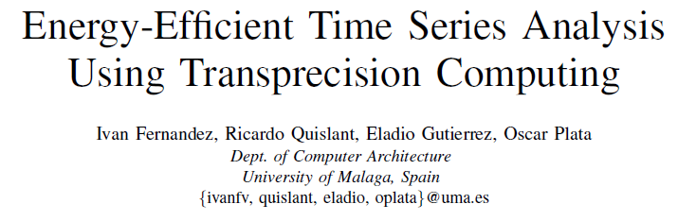
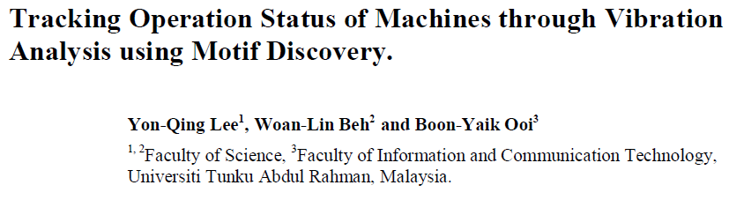
Literature Review – The most interesting papers
Since the Matrix Profile method was only introduced in 2016, the existing literature on this topic is still quite limited.
From what I was able to collect online, only a few selected papers actually introduced significant improvements/modifications to the original method and its related «fundamental» papers (that can be found at: https://www.cs.ucr.edu/~eamonn/MatrixProfile.html).
Among existing literature, papers other that the ones I am going to present mostly either focus on real-world applications of the Matrix Profile in various fields (and their main goal is usually to confirm the usefulness of the method in those specific fields) or on improving the Matrix Profile computational aspect (for example, speeding up the calculations, allowing fast computation on larger and larger datasets or consuming less energy during the process). However, in regard to our objective, these papers are not the most interesting ones.
In the next slides, I will briefly present, in no particular order, the most interesting papers that introduce novelties to the traditional MP method and their main contributions.

Slide 10
“Measuring Similarity of Interactive Driving Behaviors Using Matrix Profile», Lin et al., 2020
The most interesting aspect that emerges from this paper is the introduction of the MUSTAMP/MUSTOMP algorithms, that are used for MP computation for AB joins (the well-known mSTAMP method for this task is only able to compute time series self-joins). These algorithms can also be used when the two multivariate time-series are of unequal length and can be incrementally mantained.
These algorithms are then applied to a top-k most similar time series search task among multivariate time series composed of vehicles data such as speed, latitude and longitude. The goal is to analyze driving encounters and to find similar driving behaviors in real-world traffic environment.
In order to evaluate similarity and find top-k similar time series, a top-k query algorithm is also introduced, that «compresses» the matrix profile from a vector into a scalar in order to be able to evaluate whole time series similarity with a novel distance metric that measures similarity between two unequal-length multivariate time series.
The framework, that also has a classification and clustering step (not reported here for brevity) can be generalized to interactive behaviors such as vehicle-pedestrian or vehicle-cyclist interactions.
The authors only provide pseudocode for the introduced algorithms.

Slide 11
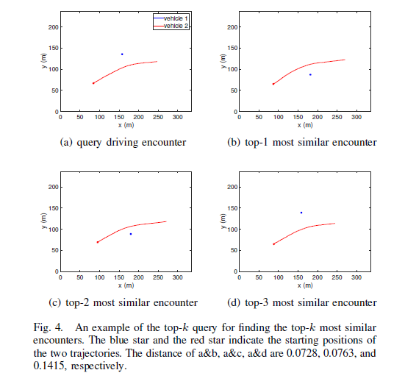
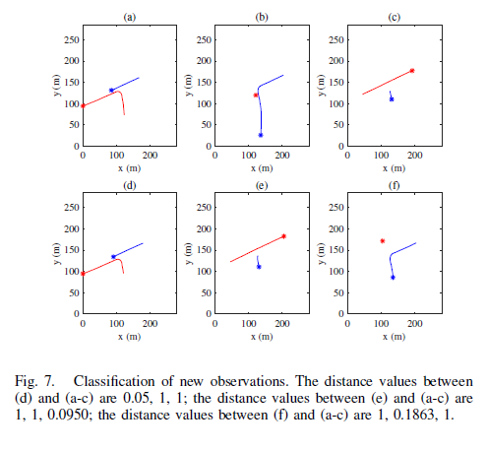
“Measuring Similarity of Interactive Driving Behaviors Using Matrix Profile», Lin et al., 2020

Slide 12
“A generalized matrix profile framework with support for contextual series analysis”, De Paepe et al., 2020
This paper introduces two main novelties regarding the Matrix Profile; the first one is the Series Distance Matrix (SDM) and the second one is the Contextual Matrix Profile (CMP);
The SDM is a framework that separates components that calculate distances between subsequences of input series (SDM-generators) from components that process these distances in a meaningful way (SDM-consumers). This allows for an easy integration of existing MP extensions from literature, that can be packaged as SDM-generators or SDM-consumers and plugged into the SDM framework, and makes it easy to combine different techniques freely without additional effort. Just as an example of the benefits deriving from this, distances can be processed only once but processed by multiple consumers in combined calculations, resulting in an overall more efficient solution. The authors released a Python library at https://github.com/predict-idlab/seriesdistancematrix that implements the SDM framework.
The CMP can be seen as a configurable, 2-dimensional version of the MP, that tracks multiple matches across window regions of the series whereas the MP tracks one match for each window. The authors suggest that beside enhanced data visualization, the CMP can also be used for detecting anomalies that are not discords. The CMP builds upon the same fundamental concept of the MP, that is the distance matrix (DM) containing the distances of all subsequences from the first input series to all distances from the second input series; the MP is defined as column-wise minimum over the entire distance matrix, while the CMP is defined as the minimum over rectangular regions of the distance matrix. These rectangles may or may not cover the entire distance matrix and their configuration is up to the user. Also, the CMP-consumer can be configured in a way that it calculates the MP; in this way, the CMP can be seen as a generalization of the MP.
The authors suggest that the main use cases for CMP are data visualization and anomaly detection.
For data visualization, the CMP can be used to gain insight into the dataset it was built on, and can be used to find patterns and deviations from these patterns that might require further investigation. The authors suggest that the main difference between CMP and MP for data visualization is that the MP is unable to capture the periodic nature of the data since each sequence is compared against all other sequences rather that multiple spans like the CMP does.

Slide 13
“A generalized matrix profile framework with support for contextual series analysis”, De Paepe et al., 2020
As an example of this use for data visualization, a case study on a dataset of New York Taxi passengers numbers is presented. The CMP that results from considering a window length of 22 hours (the remaining 2 hours are not considered for allowing temporal shift when comparing windows and each subsequence starts between midnight and 02:00) shows a pattern of small squares and indicates that there are tipically 5 days displaying similar behavior, followed by 2 days of different behavior: these periodic patterns represent the cycle of weekdays/weekends and such information can not be found when visualizing MP.
For anomaly detection, the authors examined the same dataset and applied a custom technique in order to obtain single-days anomaly scores based on the values of the CMP at each point, distinguishing weekdays from Saturdays and Sundays. Applying the Elbow method, they found a threshold to obtain the number of anomalous days in the dataset. After applying a similar reasoning to the MP (where the discords are considered anomalies), they found that the two methods returned different days as anomalous and the CMP returns anomalous days that are noticeably different from the majority of the reference days, while the MP returns various days where the «anomaly» is due to a spike or an elongated tail or a bump.
The authors end this analyses with their opinion on the CMP vs MP:
“The question arises: which of these techniques is best suited for anomaly detection? While we suspect most users will find the results of the CMP to be more insightful for this specific dataset, the general answer remains ‘‘it depends’’. Fundamentally, both techniques are searching for different things. While the Matrix Profile is looking for the most unique patterns (discords) in the series, the CMP based anomaly detection is looking for patterns that differ most from a group of reference contexts. Both approaches will have applications depending on the type of anomalies the user is interested in. Whereas a simple distance matrix between weekdays and weekends could also have found these anomalies, this assumes knowing the underlying pattern in advance. One benefit of the CMP is that it allows us to discover these patterns when the pattern is unknown in advance, which is often the case. So, assuming we did not know the weekday/weekend similarity beforehand, we could have easily deduced it by visualizing the CMP. The CMP has one other major advantage over a basic distance matrix, it allows for a (time) shift when comparing sequences, allowing us to recognize similar behavioral patterns despite them not being aligned in time. This flexibility comes at the cost of the user having to define the contexts, often having to rely on expert knowledge of the underlying process.»

Slide 14
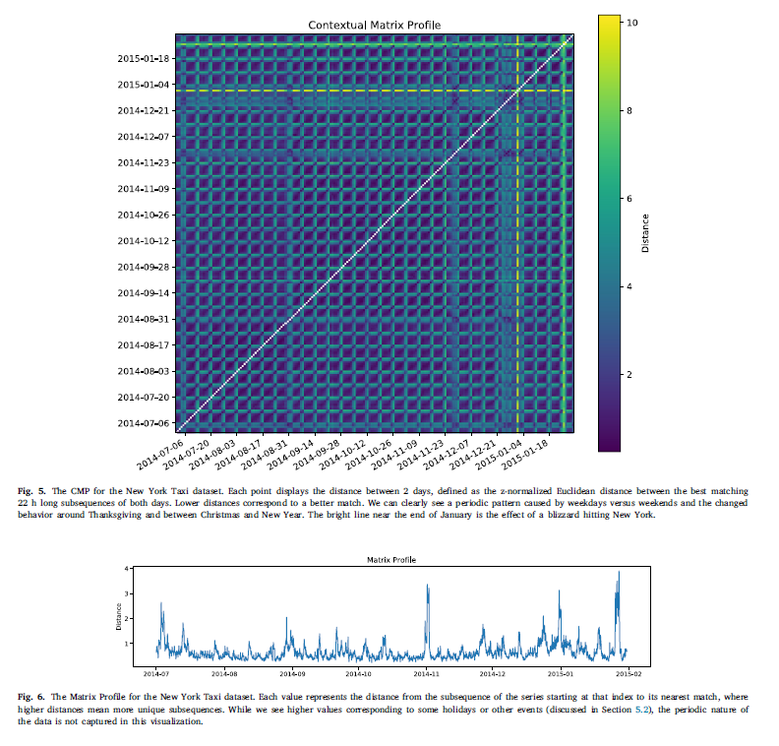
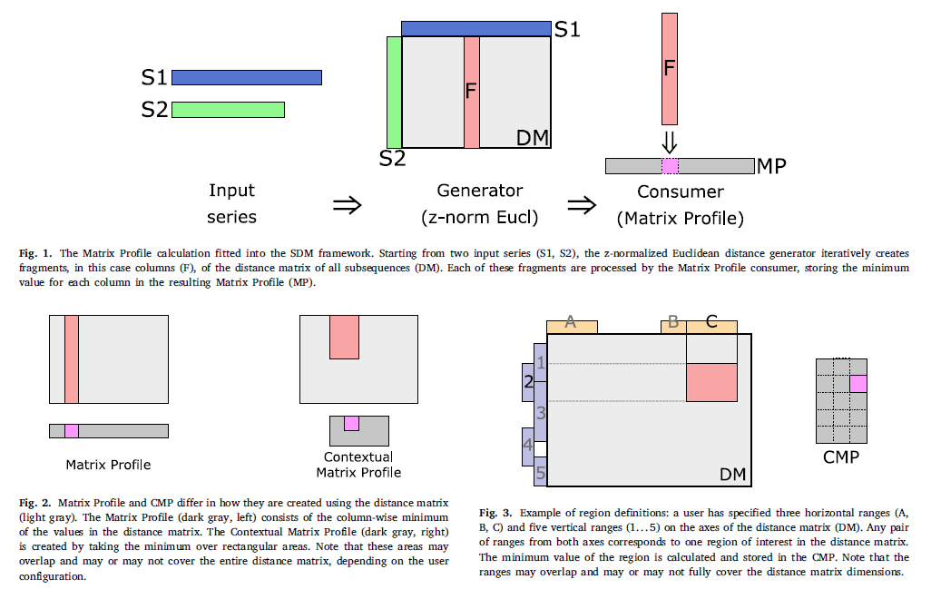
“A generalized matrix profile framework with support for contextual series analysis”, De Paepe et al., 2020

Slide 15
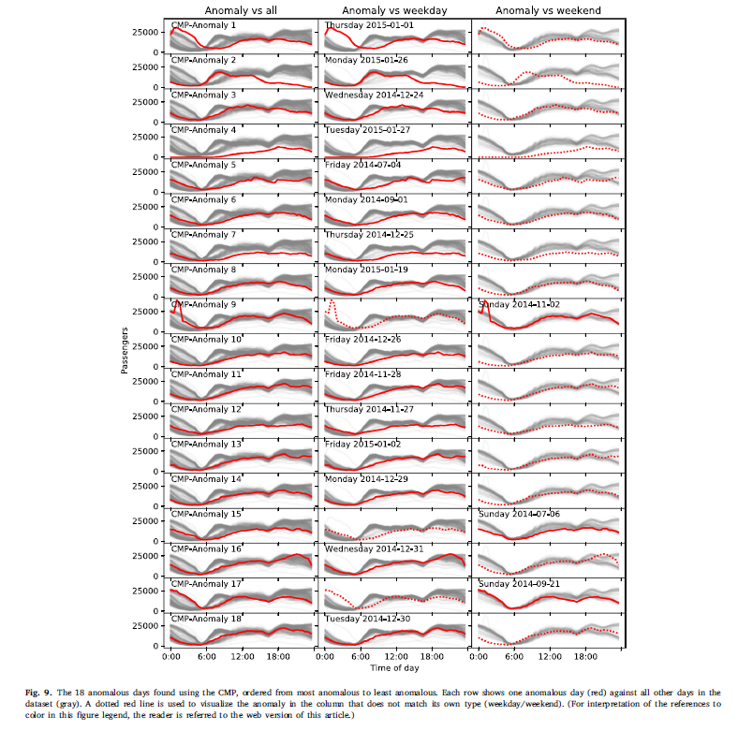
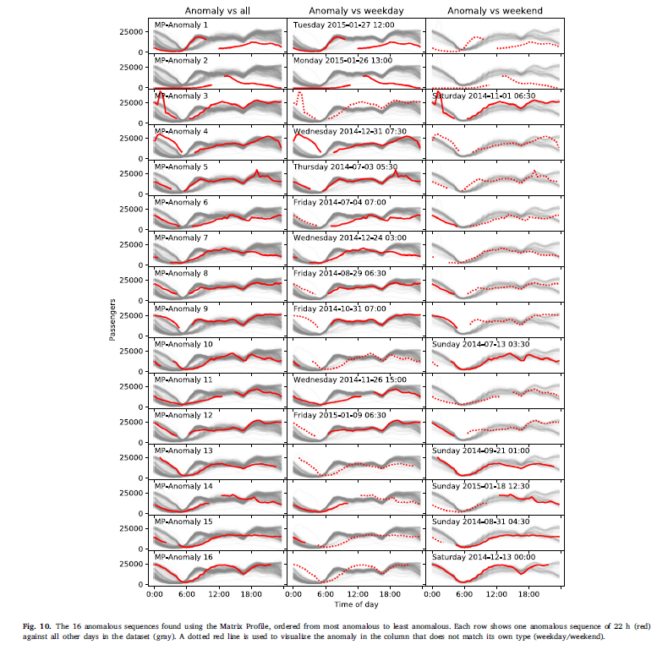
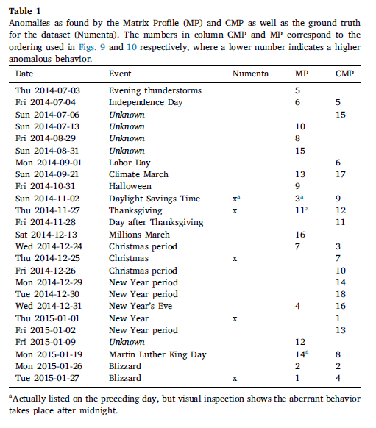
“A generalized matrix profile framework with support for contextual series analysis”, De Paepe et al., 2020

Slide 16
“Matrix Profile XVII: Indexing the Matrix Profile to Allow Arbitrary Range Queries”, Zhu et al., 2020
This paper belongs to the «fundamental» ones that are shown on the official MP website, although there is no direct link to it and the website that should contain the related code (https://sites.google.com/site/arbitraryrangemp/) appears to be empty (maybe the idea was discontinued or not completed?)
Nevertheless, the novelties presented in this work seem quite useful for the anomaly detection task in the energy and buildings field, since we may often want to focus only on certain periods of a time series and being able to do so in an automated way can speed up our research efforts by a significant margin.
The main contribution this paper makes is introducing the STUMP (Scalable Time Series Ubication Matrix Profile) algorithm, whose goal is to produce a «meta» Matrix Profile that can be precomupted and incrementally maintained and be used to quickly produce both a standard MP corresponding to an arbitrary region of a time series and a standard MP corresponding to a time series with an arbitrary region excluded.
A real-life case study is presented for a time series with a three-years length, showing that computing the full MP hides certain discords, related to recurring annual events in the three years, that are evident when computing the monthly MPs. The authors claim that with their algorithm all the monthly MPs can be computed within less than a second.
Overall, the approach can prove very useful when there is a need to analyze motifs/discords in a dataset specifying a query range, and being able to compute all the MPs in a very fast way can allow user-interactive comparison of the MPs corresponding to various ranges and their differences in terms of motifs/discords that emerge from a particular setting.

Slide 17
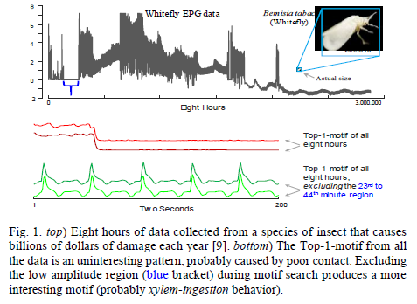
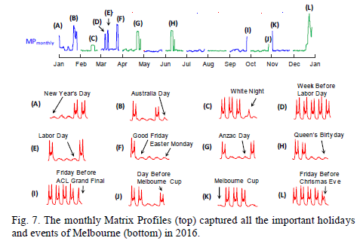
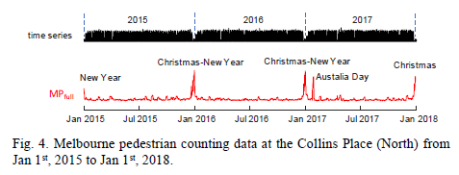
“Matrix Profile XVII: Indexing the Matrix Profile to Allow Arbitrary Range Queries”, Zhu et al., 2020

Slide 18
“Elastic Time Series Motifs and Discords”, Silva et al., 2018
In this paper, the authors introduce the a new distance for time series comparison, called the Prefix and Suffix invariant DTW (ψ-DTW distance). Their reasoning behind this novelty is that 1) the original MP algorithm uses the Euclidean distance which is not well-suited for a variety of tasks where warping (which is a small distortion of the time axis that usually occurs in motion tracking from subjects with different paces and music data with tempo differences) is a valuable feature because of the presence of nonlinear time accelerations (the authors show that the ED does not retrieve the most significant motifs/discords in application domains that tipically require warping) and 2) since working with streaming data should be fundamental for the previously listed application fields, the data may not be perfectly pre-segmented in sliding window-subsequences and there may be spurious endpoints that degrade the quality of the motifs and discords discovered.
The ψ-DTW distance allows matching two subsequences under DTW ignoring up to r (a user-defined parameter) endpoints, so that subsequences whose length differ up to 2r observations can be compared. The motifs/discords derived from this technique are referred to as Elastic Motifs (ELMO)/Discords (ELD) and a new ψ-DTW MP is constructed (Elastic Matrix Profile, EMP).
The authors suggest that Classic DTW is not perfectly suitable for the task of motif/discord discovery in the domains that require warping, since DTW may discard several motifs by considering them distant because their endpoints are disproportionately contributing to the distance.
Various case studies are presented where ED-based motifs and discords are compared to ELMO/ELD and the preference for the latter is justified for the specific applications.
Source codes and datasets for reproducibility are available at https://sites.google.com/view/elastic-motifs-discords.

Slide 19
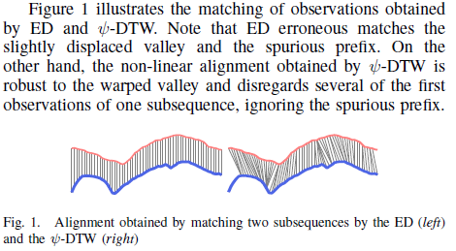
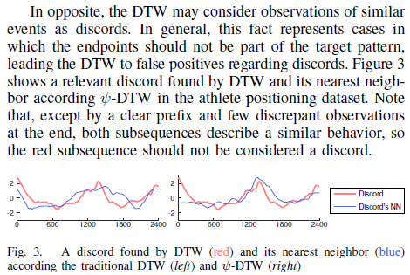
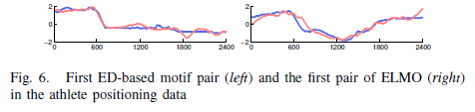
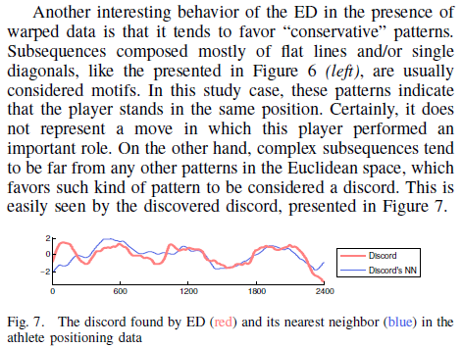
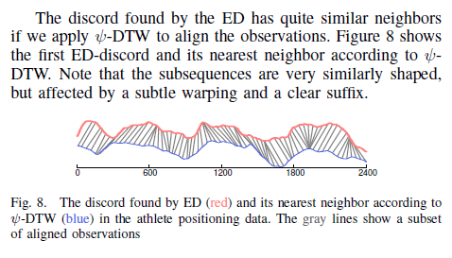
“Elastic Time Series Motifs and Discords”, Silva et al., 2018

Slide 20
«Security in Process: Detecting Attacks in Industrial Process Data”, D. Duque Anton et al., 2019
In this work, which belongs to a series of papers published by the same authors with a similar topic (analysis of attacks in Industrial Process Data, considered as a framework where the Matrix Profile is part of the process: I will not go into detail about this since the other papers mostly cite the MP as a «tool» and do not introduce significant novelties), the «twin freak» problem is taken into consideration and an extension to the traditional Matrix Profile is implemented.
The authors suggest that attacks that occur multiple times and have the same characteristics each time are not detected as attacks anymore, since they are already known behavior. In order to take care of this issue, they propose a solution that relies on counting the number of instances of a motif; a threshold value is set to compare the current motif to all other motifs and all the motifs whose distance is smaller than the threshold value are added to a list. Doing so allows to count the number of similar motifs. Therefore, they focus more on the «number of occurrences» criteria rather than the «minimum distance» criteria.
The authors claim this kind of workaround of the twin freak problem allows them to successfully identify the periods where an attack actually took place, since in those periods the number of similar motifs was particularly low, indicating a rare behavior despite a low minimum distance.
The authors do not provide the code for this extension to MP, although I imagine it would not be too difficult to implement in existing code.

Slide 21
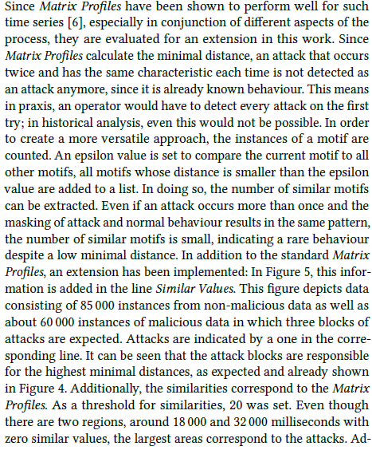
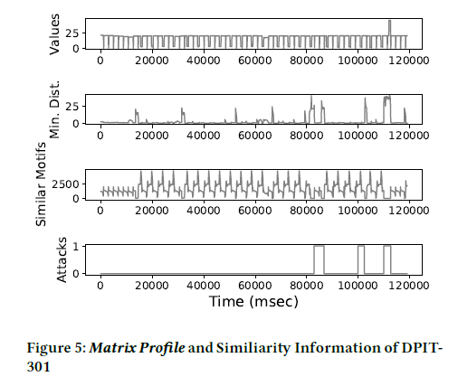
«Security in Process: Detecting Attacks in Industrial Process Data”, D. Duque Anton et al., 2019

Slide 22
“RAMP: Real-Time Anomaly Detection in Scientific Workflows”, Dinal Herath et al., 2019
This paper tackles an issue that is similar to the one seen in the previous paper, the «twin freak» problem, and also proposes a new way to compute distances between subsequences.
The authors introduce a framework, called RAMP (Real-Time Aggregated Matrix Profile), that aims at detecting anomalies in scientific workflow systems, in order to stop misbehaviors at their early stages before they contaminate the eventual scientific discovery results. Examples of these misbehaviors may be the result of external attacks such as DOS attacks.
Without going into details, such framework comprises various modules including «Anomaly Detection», that builds upon the Matrix Profile method.
The interesting modifications to the standard MP method that are made are:
limiting the number of subsequences compared, in order to avoid false negatives when in presence of a repeated anomaly instance. However, it needs to be said that RAMP introduces a semi-supervised model to apply MP and, in order to perform the limitation on the number of subsequences, the time series are considered only for the first M-m+1 subsequences, where m is the subsequence length and M is a user-set parameter whose choice does not appear to be trivial. Therefore, it may not be easy to transfer the logic used in this work to our needs.
computing relative distances among subsequences instead of the absolute Euclidean distance. The authors suggest that the purpose of this modification is to overcome the inherent bias of Euclidean distance towards numerically larger data points.

Slide 23
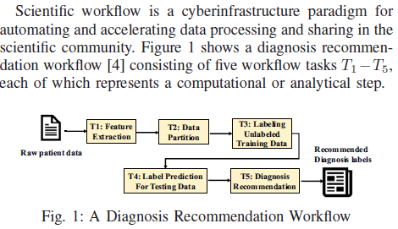
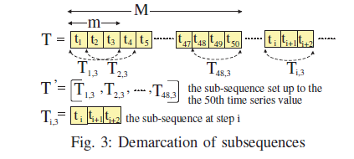
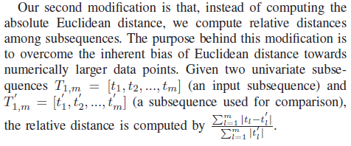
“RAMP: Real-Time Anomaly Detection in Scientific Workflows”, Dinal Herath et al., 2019

Slide 24
“MPA: a novel cross-language API for time series analysis”, H. Van Benschoten et al., 2020
Although this brief papers does not present significant novelties to the MP method itself, I think it is worth mentioning it because it introduces an «out-of-the-box» working implementation of the Matrix Profile, a cross-language platform in Python and R, without requiring specific programming language knowledge and can be useful for both novices and experts.
MPA consists of three core API (Application Programming Interface: a type of software interface, offering a service to other pieces of software) components: 1. Compute, which computes the Matrix Profile, 2. Discover, which provides methods for evaluating the MP for motifs & discords and 3. Visualize, which displays results through basic plots. These three capabilities are wrapped up into a high-level capability called Analyze, a user-friendly interface that enables individuals lacking prior knowledge about the inner workings of Matrix Profile to quickly leverage it on their own data. With a single line of code, Analyze combines the pan-Matrix Profile with an under the hood algorithm to choose the three most sensible motifs and discords from across all possible window sizes.
As users gain more experience and intuition with MPA and its outputs, they can easily dive deeper into any of the three core components to make further functional gains.
The software-related material is available at: https://github.com/matrix-profile-foundation/joss_paper, https://github.com/openjournals/joss-reviews/issues/2179 and https://zenodo.org/record/3789780.

Slide 25
«An Automated Matrix Profile for Mining Consecutive Repeats in Time Series”, Mirmomeni et al., 2018
The authors of this paper introduce a novelty in the MP methods that allows for the discovery of Consecutive Repetitive Patterns (CRPs), that are particularly relevant in the domain of human activity tracking with the help of wearable sensors. While traditional MP is able to find motifs in a dataset, no information regarding the temporal closeness (locality) of the repeats is preserved.
The authors also suggest that the subsequence length, the input parameter of traditional MP, is a «weakness» of MP because of its high sensitivity to it (for example, choosing a subsequence length that is too large reduces the chance of finding similar subsequences while choosing a value that is too small may result in most of the subsequences being assesses similar with each other) and their proposed algorithm for finding CRPs has zero parameters to be set.
A Distance Index (DI) is therefore introduced, which is a vector that at each point stores the distance between the index of any subsequence of length m of a TS to the index of its NN. The Most Repeat-Sensitive DI is also defined as a DI that aligns to the period of the repeating pattern and stays flat for the duration of the repeat, in order to find a value of m that results in a DI that best detect the area of CRPs.
The authors prove via theorems that to achieve the most-repeat sensitive DI, the input parameter m has to be set to the length of the shortest subsequence that is not repeating within the signal of repeat; they also claim that their algorithm (for which a code or pseudocode reference, however, is not provided) is able to automatically find a value of m (they show how automatically determine the best m) that outperforms selecting m using domain knowledge by 15% for a specific case study on a Physiotheraphy dataset and that their method is able to find the regions of CRPs in the same dataset automatically and without a priori knowledge about the regions.

Slide 26
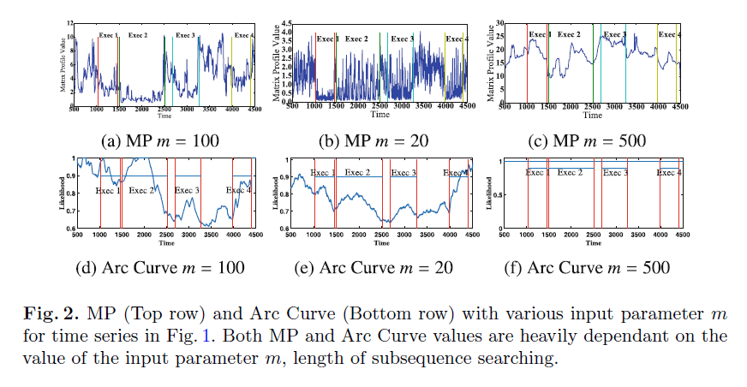
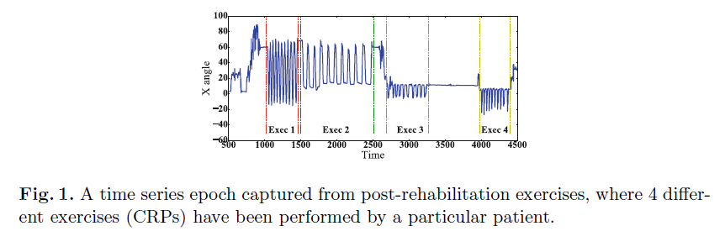
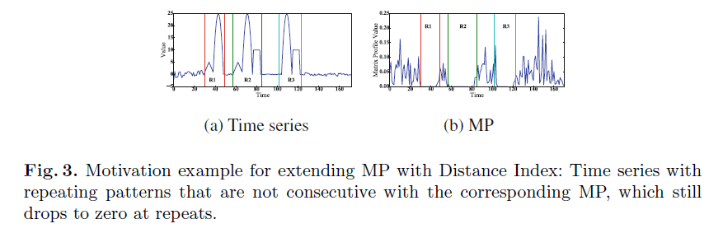
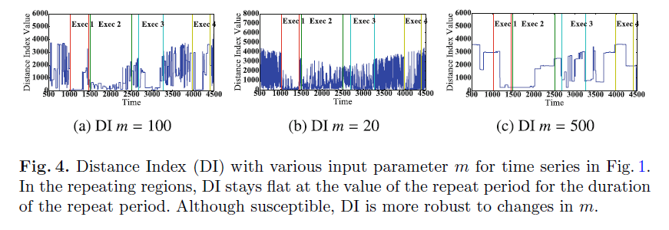
«An Automated Matrix Profile for Mining Consecutive Repeats in Time Series”, Mirmomeni et al., 2018

Slide 27
“A Two-Dimensional Sparse Matrix Profile DenseNet for COVID-19 Diagnosis Using Chest CT Images”, Liu et al., 2020
This paper introduces a framework that integrates an image preprocessing technology for anomaly detection with supervised deep learning for chest CT imaging-based COVID-19 diagnosis. While the whole framework is not particularly interesting for us, the authors propose a novelty to the traditional MP methods, that is the MP calculated at a two-dimensional level, in order to be able to treat a group of points (pixels) in the same way as a time series.
By doing so, they extend the concept of Matrix profile to high dimensional data (in this case, two-dimensional data), which is an avenue that, at the time of the publishing of this work, had not yet been explored (the most similar concept is that of Contextual Matrix Profile).
The authors suggest that the alternative method to evaluate the same 2-dimensional data by flattening a matrix of values into a vector and then treat it as a time series.
The 2-dimensional MP is derived by defining segments of the «main» matrix of points, each one with a constant width w and height h, by sliding a w x h window. Those segments are then aggregated to form a «sparse segment set» S and the «sparse 2-dimensional MP» (2DM) is defined as the matrix of Euclidean distances, that has the sime size as S, between each segment in S and its NN in S. To calculate the 2DM, the pairwise Euclidean distance between one element in S with every other element in S is applied. The minimum of these distances is finally stored in the same position in 2DM as the element in S. The rest of the reasoning is the same as standard MP (largest NN distances indicate probable anomalies).
While the rest of the paper further develops analyses and observations after calculating the 2DM, the main relevant aspect of our possible interest, in my opinion, is the extension of the MP to a «group» of points that are not consecutively ordered.

Slide 28
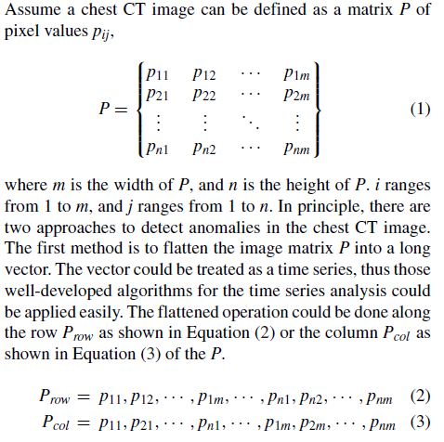
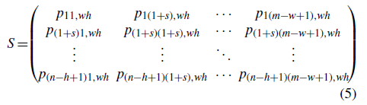
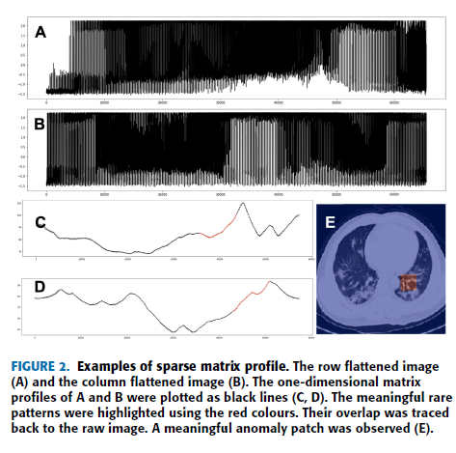
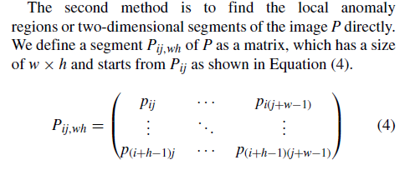
“A Two-Dimensional Sparse Matrix Profile DenseNet for COVID-19 Diagnosis Using Chest CT Images”, Liu et al., 2020

Slide 29
“Fault Detection and Classification of Time Series Using Localized Matrix Profiles”, Zhang et al., 2019
In this papers, the authors introduce a new primitive for time series data mining, called Localized Matrix Profile (LMP). The main reason for this contribution is, once again, the need for being able to deal with the «twin freak» problem.
In my opinion, the solution found to tackle this issue in this paper is quite domain-specific and thus it might not be too easy to transfer to our research field. The considerations below illustrate how domain-specific the approach is.
The authors propose the LMP as a tool that is well-suited for applications where the data are statistically time varying: throughout the paper, they only consider transient systems (physical devices such as electrical motors) where multiple runs of the same «process» are evaluated, each one tipically producing a multivariate time series (MTS). Each time series (representing a specific variable) in a MTS comes from a sensor. A set of baseline MTS items is first produced and the LMP compares a new MTS items to the baseline set, that is composed of L items. Since different variables (sensors) could contribute differently in fault detection and classification, they also introduce a vector that assigns specific «importance weights» to the each sensor.
In short, the LMP only compares distances of subsequences that belong to MTS items (the comparison is a new item join with the baseline set) with the same starting time t (the same time instance) in order to take account of the time-varying nature of the system that may lead to false positives/negatives otherwise, while the traditional MP computes NN searching over all available subsequences involved in the MTS, no matter where they start.
A LMP-based fault detector and a LMP-based fault classifier are then developed and the reasoning behind how to build them is explained in a «general» way.
A case study using synthetic sensor data generated from a physical model of an electrical motor is then presented, and the advantages in terms of speed to existing alternative methods.
The authors provide the pseudocode for their algorithms.

Slide 30
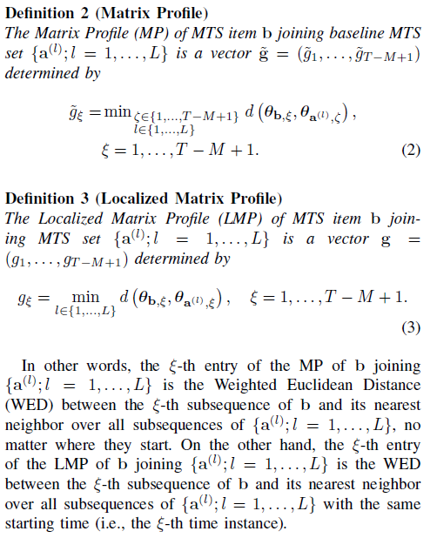
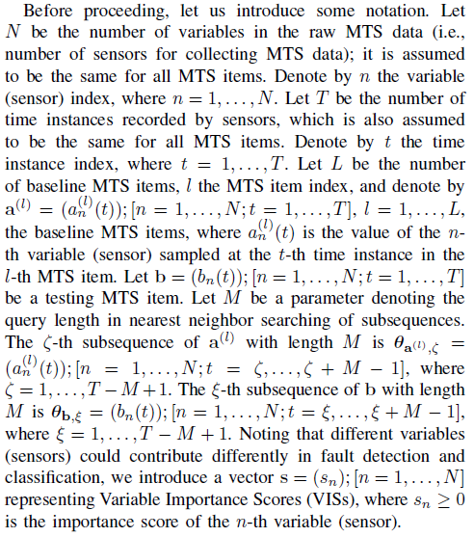
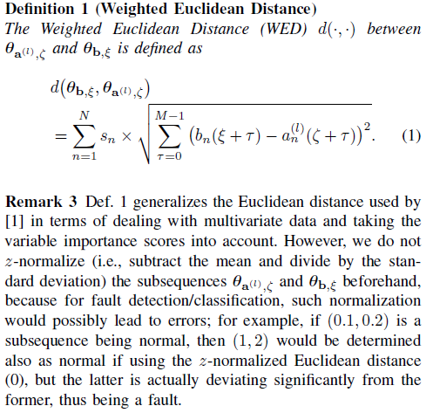
“Fault Detection and Classification of Time Series Using Localized Matrix Profiles”, Zhang et al., 2019

Slide 31
“Temporary rules of retail product sales time series based on the matrix profile”, Li et al., 2020
This paper does not introduce significant modifications to the MP methods or proposes solutions to a specific problem in traditional MP, but the framework presented is interesting in its entirety.
The authors introduce the above mentioned framework for the study of correlation of product sales, in order to extract temporary rules after discovering multivariate motifs, that can assist business managers in their work.
The reasoning behind this work is that often certain products are purchased together due to a specific time of the year or event (for example, drinks and food that are more typical of summer season). In market basket analysis, it is therefore essential to know which products have sales correlation to facilitate bundle sales. It is also useful to know when it is suitable to recommend certain products to the customers and how long the recommendation should last, and this can be achieved by using multi-motifs derived from similar subsequences and evaluate the length of these multi-motifs.
The approach is the following: first, the similarity between a series of product sales is studied; the relationships between products are then used to construct a similarity network of product sales; according to this network, different groups of products can be selected and the products sales time series in such groups are considered as a multivariate time series. If the multi-motifs that can be found in these multivariate TS are repeating, it implies that the temporary relationships that they represent are frequent. In the last stage, Temporary Rules (TR) (association rules that take into account the aspect of temporality and quanity rather than probabilty) are generated from a multi-motifs set.
The explanation of the whole process (how everything is calculated in detail) would be quite long to report in its entirety (pseudocode is available for each algorithm; essentially, for what concerns MP, no significant modifications are introduced with respect to the traditional methods; the way everything is combined, however, is slightly different to what we are used to compute) therefore I will briefly sum up what I think are the most important contributions that this paper can offer to our research field.

Slide 32
“Temporary rules of retail product sales time series based on the matrix profile”, Li et al., 2020
When dealing with multidimensional time series in our field, we may have temporal correlations between the sub-loads, and this kind of framework can be useful to understand which sub-loads are more related to others, through a logic of degree of similarity as the one seen in this paper.
If we are able to identify such correlations and extract Temporary Rules, we can apply certain actions in order to take care of possible issues that may emerge in a subset of sub-loads in a periodic way. One of the weaknesses of TRs that the authors suggest, however, is the lack of a proper numerical standard.

Slide 33
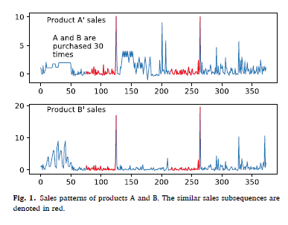
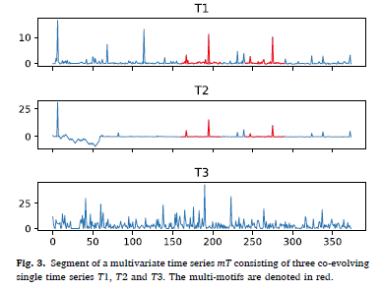
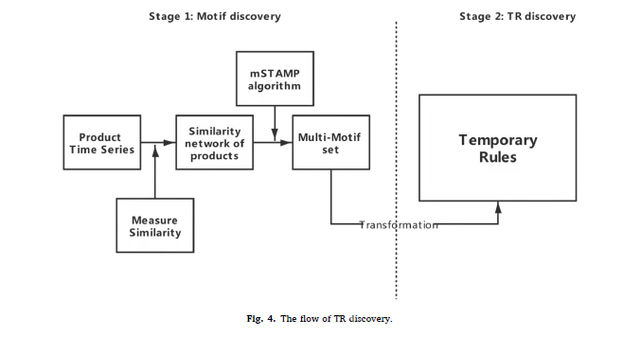
“Temporary rules of retail product sales time series based on the matrix profile”, Li et al., 2020

Slide 34
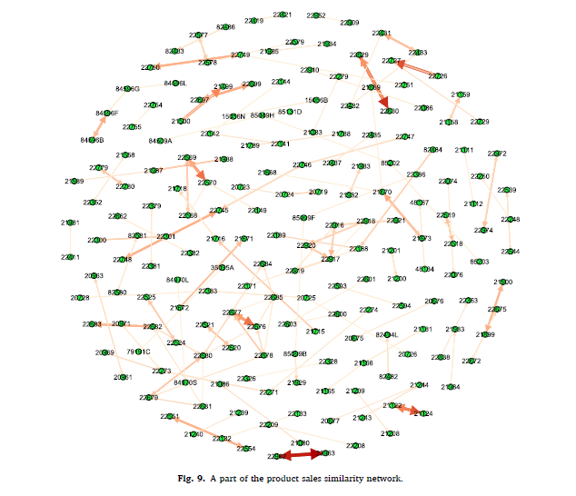
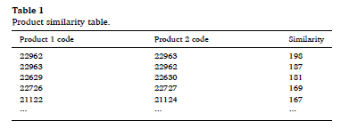
“Temporary rules of retail product sales time series based on the matrix profile”, Li et al., 2020

Slide 35
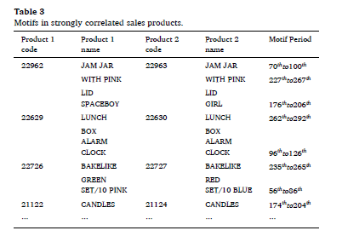
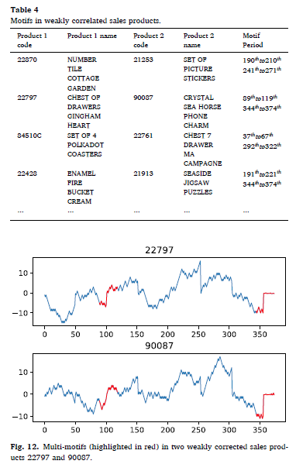

“Temporary rules of retail product sales time series based on the matrix profile”, Li et al., 2020

